Slide 1

Puzzle of the day
class Dog {
public static void bark() {
System.out.print("woof ");
}
}
class Basenji extends Dog {
public static void bark() { }
}
public class Bark {
public static void main(String args[]) {
Dog woofer = new Dog();
Dog nipper = new Basenji();
woofer.bark();
nipper.bark();
}
}
Basenji
(doesn’t bark)
What does this program do?
Notes:
Static methods bypass dynamic dispatch. The JVM determines which static method to invoke by looking at the declared type of the local variable (Dog in this case) and invoking that class’s static method. In this example, you can even make null bark, provided you cast null to Dog first! In general, you should only invoke static methods by explicitly using the class name, e.g. Dog.bark() and Basenji.bark(). In cases like this example, where we expect dynamic dispatch, simply do not use the static keyword.
Static types thus break a lot of object oriented design. To minimize the impact of static types, we prefer the Singleton pattern where the global behavior is desired, and otherwise avoid the static keyword.

Slide 2
Quiz: what does this program do?
public class TooEager {
private static TooEager uniqueInstance = new TooEager();
private static int magicNumber = 14;
private TooEager(){
System.out.println(magicNumber++);
}
public static TooEager getInstance(){
return uniqueInstance;
}
public static void main(String[] args){
// TooEager is eagerly constructed, so it prints first, then this.
System.out.println(magicNumber);
}
}
Notes:
Reasonably expect to print 14 and 15, but really prints 0 and 14!
magicNumber = 14 is not executed in time.
The decision to use eager vs lazy instantiation is not obvious.

Slide 3
Singleton and Command Patterns
Week 6-1

Slide 4
Outline
Exam 2 announcement
The Gang of Four taxonomy
A few words on Singleton
Questions on Singleton
Questions on Command

Slide 5
Exam 2 / PLC conflict
Exam 2 is next week, Tuesday at 7:30
Some of you are taking PLC and failed to notice that your PLC exam is scheduled at the same time as our Exam 2.
Email me to formally ask for another time to take the 374 exam.

Slide 6
Recall: Gang of Four Design Patterns
Behavioral
Strategy
Observer
Command
Creational
Factory Method
Abstract Factory
Singleton
Structural
Decorator
Two observations:
Strategy, Observer, and Command all feel the same because they are all Behavioral.
Singleton is a pattern for:
Creating, like Factory!
One and only one instance.

Slide 7
Singleton

Slide 8
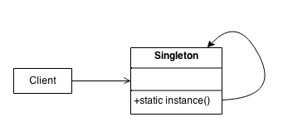
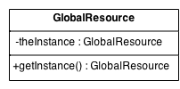
Singleton: Creational Pattern
Problem: How do we ensure that exactly one instance of a class is created and is globally accessible?
Solution: Define a static method in the class that returns the singleton instance
Created only once for the life of the program (a non-creational pattern?)
Provides single global point of access to instance
Similar to a static or global variable variable
Notes:
Problem: Exactly one instance of a class is needed/allowed
Other objects need single, global point of access to it
Solution: Define a static method of a class that returns the Singleton
The static method can only create one instance
Issues
Who should create the Factory? The Singleton!
Provides global visibility via static method
Avoids passing factory reference to many clients

Slide 9
Using a Singleton Design Pattern
Consider the Logger and how it is accessed – who creates the Logger?
Only want one instance of the logger
Logging Methods may need to be called from various places => how to make single instance of the Logger globally visible
Could pass the Logger instance around as a parameter whenever visibility is required or initialize all objects that need it with a permanent reference to it
Involves some coupling issues
Singleton – supports global visibility or a single access point to a single instance

Slide 10
How Singleton Logger Used
Logger
instance : Logger
allocateChannel : IAllocateChannel deallocateChannel : IDeallocateChannel
getInstance: LoggerFactory
getInstance() : Logger
getAllocateChannel() : IAllocateChannel getDeallocateChannel() : IDeallocateChannel
Logger getInstance()
null ) Logger
Notes:
All clients have global visibility to static method getInstance()
First call to getInstance() creates a Logger singleton
- Subsequent calls just access the singleton
Concurrency control in Logger – making getInstance() synchronized (this no longer needed in later versions of Jave as it would be thread-safe).

Slide 11
Lazy vs. Eager Initialization
Lazy:
private static Logger instance; public static Logger getInstance() { if (instance == null) instance = new Logger(); return instance; }
Eager:
private static Logger instance = new LoggerFactory(); public static Logger getInstance() { return instance; }
Pros and cons?
Notes:
• build in eager version
Lazy initialization:
- saves resources by only creating if needed
- allows for more complex initialization logic
Eager:
- simple, little or no conditional logic

Slide 12
Singleton: Applicability
Use the Singleton Design Pattern…
To add unique object instance for a given class, e.g.:
Print spooler, File System Window Manager
Singleton answers the question: How to design the class such that any client cannot create more than one instance of the class?

Slide 13

Singleton Pattern: Consequences
Controlled access to sole instance
As the constructor is protected, the class controls when an instance is created
Reduced name space
Eliminates need for global variables that store single instances
Permits refinement of operations and representations
You can easily sub-class the Singleton
Permits a variable number of instances
Class is easily modified to allow n instances when n is not 1
More flexible than class operations
This pattern eliminates the need for class (i.e. static) methods

Slide 14

Singleton Considered Harmful?
Introduces global dependencies
Hard to test since it introduces global state (also leaks resources)
A Singleton today is a multi-ton tomorrow
Low cohesion — class is responsible for domain duties and for limiting number of instances
Favor Dependency Injection
Instead, use Factory to control instance creation
http://blogs.msdn.com/scottdensmore/archive/2004/05/25/140827.aspx
http://tech.puredanger.com/2007/07/03/pattern-hate-singleton/
Notes:
Singleton is probably the most overused pattern.
Many consider Singleton a bad code smell.
Q8: List four ways that using singleton can lead to problems:
•••••• Animated bullets and some solutions in call-outs

Slide 15
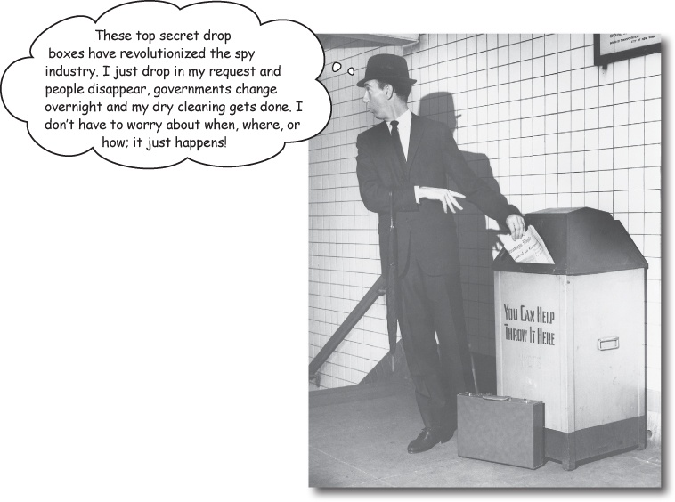
Today
We take encapsulation to a whole new level: we’re going to encapsulate method invocation!
That’s right! We can crystallize pieces of computation so that the object invoking the computation doesn’t need to worry about how to do things, it just uses our crystallized method to get it done

Slide 16
Questions on Singleton

Slide 17
Private constructors?
I am just confused on why the Singleton constructor needs to be private. Why is it better to make it private with a getInstance method rather than making a public constructor?
Using private constructors seems odd to me. It doesn't really make sense to my why they would exist except for this express purpose. Is there any other reason to sue one?
What terrible thing will happen if you make the constructor public?

Slide 18
Abuses?
Are there any other major benefits to the Singleton pattern other than ensuring that a class only has one instance.
In the last part of the chapter, it mentions that there are ways for Singleton to be abused, but it doesn't give specific examples of how this could occur. What are some common ways for Singleton to be abused/used incorrectly?
Notes:
Hidden benefit: gives lazy programmers an excuse to put things into global state.

Slide 19
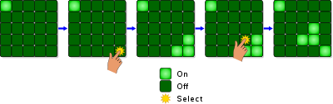
Consider this 220 problem
2D version of “Linear Lights Out” homework
How would you design the ActionListener?
https://en.wikipedia.org/wiki/Lights_Out_(game)

Slide 20

Relevant quote

Slide 21
To recap
When you invoke the static getInstance() method, you care where the Singleton comes from.
Caring where things come from is an antipattern.
There are lots of ways to not care.
Fowler:
Make all Singleton methods static.
Store state in instance variables.
I prefer the dependency injection approach.

Slide 22
Guice @Singleton – DIP approach
// One and ONLY one MySingleton shared with everyone
bind(ChocolateBoiler.class)
.toInstance(ChocolateBoiler.getInstance())
.in(Singleton.class)
…
// Singleton’s origin is now entirely hidden by Guice
@Inject
public ChocolatePizza(ChocolateBoiler singleton)
Notes:
Some of you wondered whether Java had a more factory way of creating Singletons.
Guice has an annotation @Singleton

Slide 23
Guice can make anything a Singleton!
// SlicedPepperoni is now a Singleton!
// It did not know it was going to be a Singleton!
bind(Pepperoni.class)
.toInstance(new SlicedPepperoni())
.in(Singleton.class)
…
// Its Singleton nature is STILL hidden
@Inject
public SriramPizza(Pepperoni pepperoni)
Notes:
Some of you wondered whether Java had a more factory way of creating Singletons.
Guice has an annotation @Singleton

Slide 24
Service Locator
Is http://www.martinfowler.com/articles/refactoring-dependencies.html#IntroducingServiceLocator considered a good things to do or do we always stick to the book's definition of singleton?

Slide 25
Service Locator
class Gondorff…
private DataSource dataSource;
public Gondorff(DataSource dataSource) {
this.dataSource = dataSource;
}
private DataSource getDataSource() {
return (dataSource != null) ? dataSource : ServiceLocator.dataSource();
}
public double gondorffNumber(String product) {
return getDataSource().salesDataFor(product, gondorffEpoch(product), hookerExpiry())

Slide 26
Singletons and multithreading?
Could you provide an example where singletons would be useful with multi threading? The design seems to discourage more than one thread.
Notes:
That is the prime use case.

Slide 27
How would you design this code?
Thread n_1 = new Thread(){
public void run(){
// compute fib(n-1)
}
};
Thread n_2 = new Thread(){
public void run(){
// compute fib(n-2)
}
};
// run and join result

Slide 28
Sharing state is a thread problem
Thread n_1 = new Thread(){
public void run(){
// compute fib(n-1)
}
};
Thread n_2 = new Thread(){
public void run(){
// compute fib(n-2)
}
};
// run and join result

Slide 29
Questions on Command
And also that Java 8 syntax

Slide 30
Is Command common?
I can actually see ways this could be used in real life. Is this a common pattern you see in industry?
Notes:
Design patterns are not some academic theory.
All of the design patterns we read about were identified in the wild and just given names by the Gang of 4.
To answer the question: yes, Command was common and distinct enough that the Gang of 4 felt the need to distinguish its purpose from Strategy.

Slide 31
When should we use this?
Is the command pattern ever useful when you have complete control over the code being used?
For instance in the example the book gave it was useful because the third party devices all had different interfaces, and they could not change them, which makes sense, but is there a reason it would be preferable when there is an option to change the interface instead?
What are some examples of when you wouldn't want to use the Command Pattern?
Notes:
Command doesn’t make sense if the action being taken is not an open-ended point of change.
Command doesn’t make sense if you need to take a variable number of actions – use Observer instead.

Slide 32
Anonymous classes?
I'm not sure I follow the purpose of using anonymous classes for the command pattern rather than making concrete classes. Is it just to avoid making extra files through class declarations/write more concise code?
Notes:
Have you ever used anonymous inner classes?
Why did you use them?

Slide 33
Runnable vs Command?
Runnable
Command
Interface
Defines a run method.
Can be constructed inline using a lambda.
Interface
Defines an execute and undo method.
Concrete classes must implement both methods.

Slide 34
So what is wrong with this code?
Command c = new Command(commandLambda, undoLambda);
c.execute();
c.undo();

Slide 35
Undo?
The undo functionality seems nasty to implement. For example the one in the book doesn't correctly reset switch state (it will just flip it again even if the same button was pressed twice in a row). Is there a good way to do this?

Slide 36
Undo using a Fowler Singleton
Have a global State class
Fowler-style Singleton: all static methods
Static operations on the global State push the old state onto a bounded Stack of old States
Undo: replace the current global state with a popped state.

Slide 37
What is this code doing?
interface MethodReference{
public void call(String arg);
}
public class MysteryCaller{
public void referencedMethod(String caller){
System.out.println("Who calls me? " + caller);
}
public MysteryCaller(){
MethodReference method = this::referencedMethod;
method.call("The constructor");
}
public static void main(String[] args) throws IOException{
MysteryCaller reference = new MysteryCaller();
}
}
Notes:
One student asked: what the heck is going on with method references?
The interface MethodReference is a bit of a misnomer because I could have called it anything.
In general: any method reference can be converted to any interface that contains only a single method matching the method’s signature.

Slide 38
The bytecode reveals the magic
L1
LINENUMBER 34 L1
ALOAD 0
INVOKEDYNAMIC call(Lexample/MysteryCaller;)Lexample/MethodReference; [
// handle kind 0x6 : INVOKESTATIC
java/lang/invoke/LambdaMetafactory.metafactory(Ljava/lang/invoke/MethodHandles$Lookup;Ljava/lang/String;Ljava/lang/invoke/MethodType;Ljava/lang/invoke/MethodType;Ljava/lang/invoke/MethodHandle;Ljava/lang/invoke/MethodType;)Ljava/lang/invoke/CallSite;
// arguments:
(Ljava/lang/String;)V,
// handle kind 0x5 : INVOKEVIRTUAL
example/MysteryCaller.referencedMethod(Ljava/lang/String;)V,
(Ljava/lang/String;)V
]
Notes:
One student asked about method references.
Starting in this milestone, you will be taking a deep dive into the Java byte code. As you browser through your methods’ instruction lists, you will see code that looks like this.

Slide 39
Equivalent code
interface MethodReference{
public void call(String arg);
}
public class MysteryCaller{
public void referencedMethod(String caller){
System.out.println("Who calls me? " + caller);
}
public MysteryCaller(){
MethodReference method = new MethodReference(){
public void call(String arg){
MysteryCaller.this.referencedMethod(arg);
}
}
method.call("The constructor");
}
public static void main(String[] args) throws IOException{
MysteryCaller reference = new MysteryCaller();
}
}
Notes:
One student asked: what the heck is going on with method references?
The interface MethodReference is a bit of a misnomer because I could have called it anything.
In general: any method reference can be converted to any interface that contains only a single method matching the method’s signature.

Slide 40
Start two threads to print Hello World
Thread t1 = new Thread(new Runnable(){
public void run(){
System.out.println(“Hello World”));
}
} );
t1.start();
Thread t2 = new Thread(() -> {
System.out.println("Hello World");
});
t2.start();
Notes:
The first code creates an anonymous inner class, e.g. MysteryCaller$0, that implements Runnable at compile time.
The second code creates a method reference to a method called lambda$0 at compile time. The method reference is compiled into the type Runnable at runtime.

Slide 41
Working example?
Is there anywhere I can find somewhere with a working example of this pattern? I find myself struggling to follow the book sometimes.
Notes:
The book’s example is given to you in today’s lab.

